Slide 1
Lending Club Case study

Slide 2
AGENDA
Introduction
Problem Statement
Data Understanding
Data Cleaning & Outlier Treatment
Univariate analysis
Bi Variate analysis
Summary

Slide 3
Introduction

Slide 4
Introduction
Who is Lending Club?
Lending Club is a consumer finance company which specializes in lending various types of loans to urban customers.
Like any lending firm, they want to keep their losses to a minimum
They provide loans for various types of purposes like, Small business, car, home etc.
This company is the largest online loan marketplace, facilitating personal loans, business loans, and financing of medical procedures

Slide 5
Problem Statement

Slide 6
The Lending club NEEDS to better plan on whom they provide the loans to minimize their overall Loses
Current State
Future State
This company is the largest online loan marketplace, facilitating personal loans, business loans, and financing of medical procedures
Like most other lending companies, lending loans to ‘risky’ applicants is the largest source of financial loss (called credit loss)
In the recent times, they have seen an increase in the number of Loans which is charged off
The company understand the right portfolios of the people who are high risk and low risk
They understand the driving factors behind loan default
Based on the newly found understanding, they now do much better by reducing the overall losses due to a charge off

Slide 7
Data Understanding

Slide 8
Data understanding
The provided data contains the following :
Monthly list of members who has taken a loan from the lending club
What is the current status of the loan
Demographics of the user in terms of Employment, Income, State, pin code etc.
Loan details like purpose, amount, last payment, issued ate etc.

Slide 9
Problem Solving Method
Outlier Treatment
Null Value Treatment
Missing Value treatment
Standardize metrics
Filter Data
Analyzing continuous Variables by binning them into categorical Variables
Enlisting the recommendation based on the insights generated during the EDA
Data Understanding
Data Cleaning
Univariate Analysis
Segmented Univariate Analysis
Multivariate Analysis
Business Insights
Going through Data dictionary and making sense of what the data is about
Distribution Analysis of each column
Analyzing impact of variables on the main variable for solving the business problem

Slide 10
DATA Cleaning
Removing columns with more than 50% of null values
Remove columns having only 1 value
Remove columns which doesn’t have business significance on the loan status post approval of loan
Removing duplicates
Using mode for imputing null values
Using mean for imputing null values
Filtering rows which have minimal impact
Removing outliers based on each column
Reducing data for only charged off and fully paid as current has no bearing with the analysis
Converting date columns into to date time
Converting percentages to float data types

Slide 11
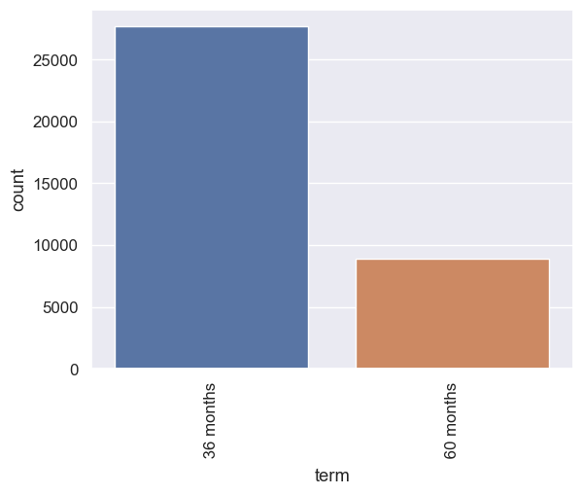
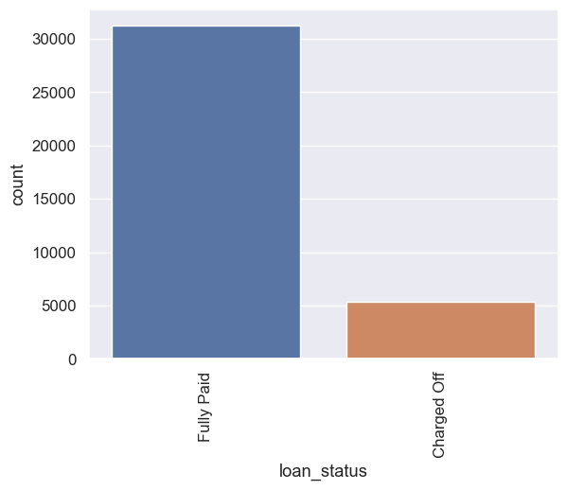
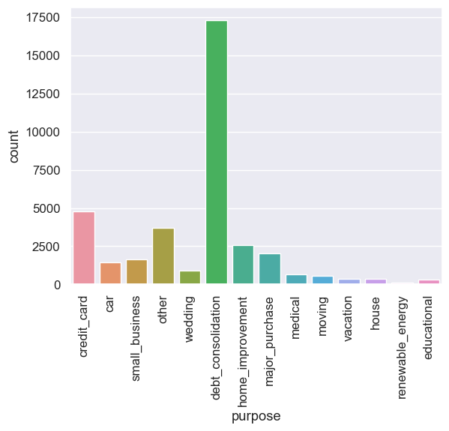
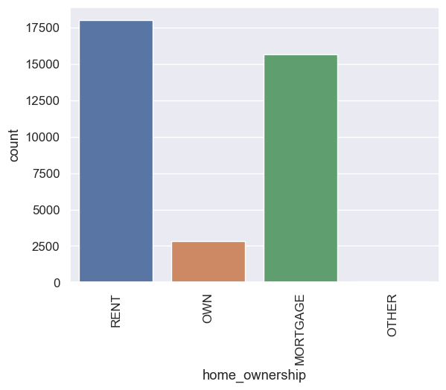
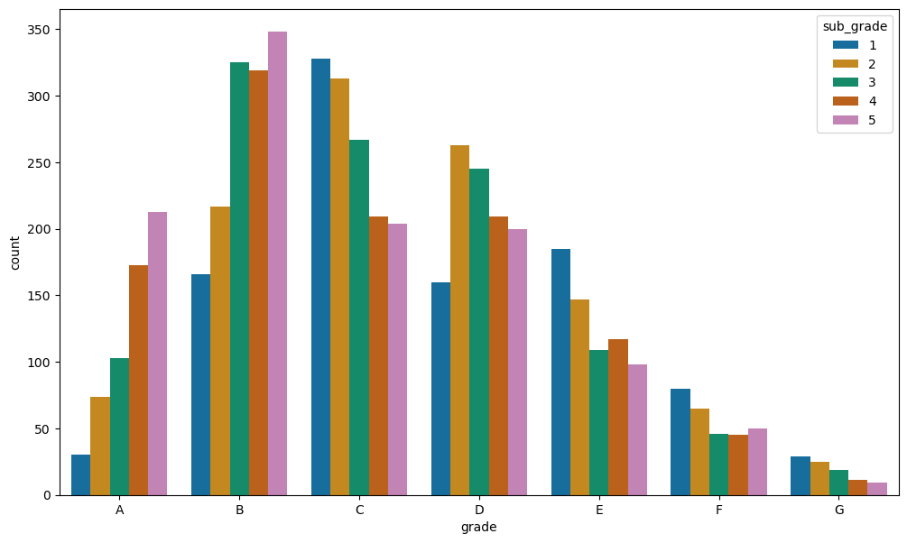
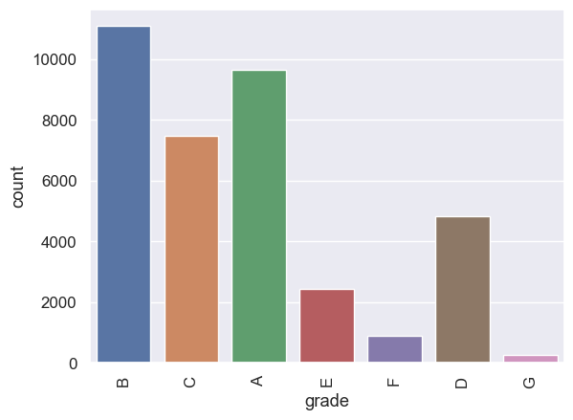
Univariate Analysis Distribution charts
Purpose – debt consolidation highest
Home – Highest in rented or mortgaged
Term
Loan Status
Grade – lower grade takes most loans
Sub Grade – In lower grades, the subrades which are lower are less approved of loans, while in higher grades, higher subgrades take lesser loans

Slide 12
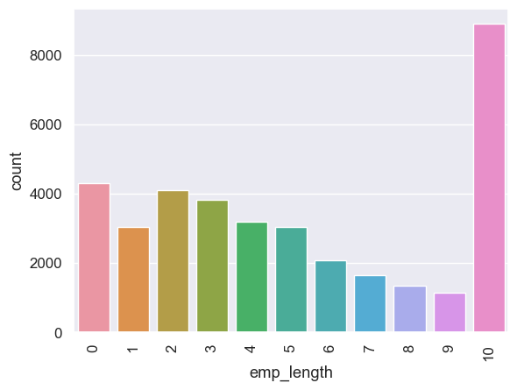
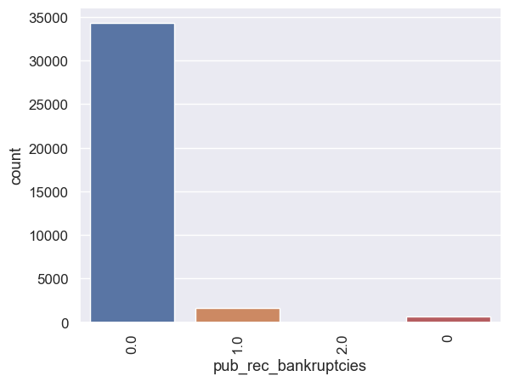
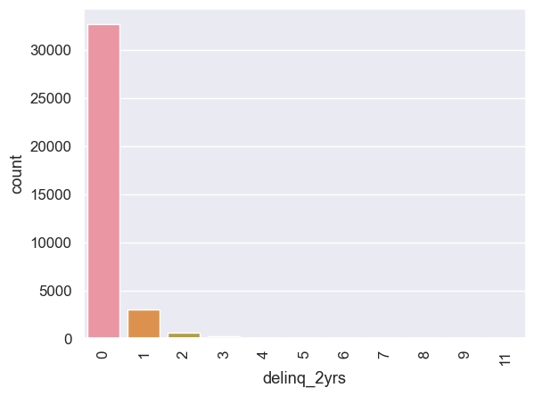
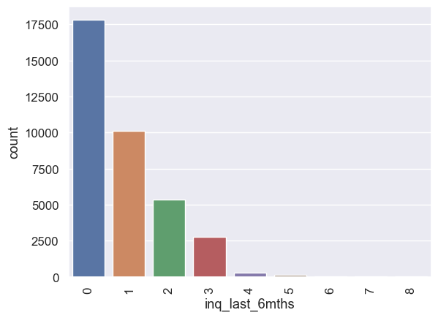
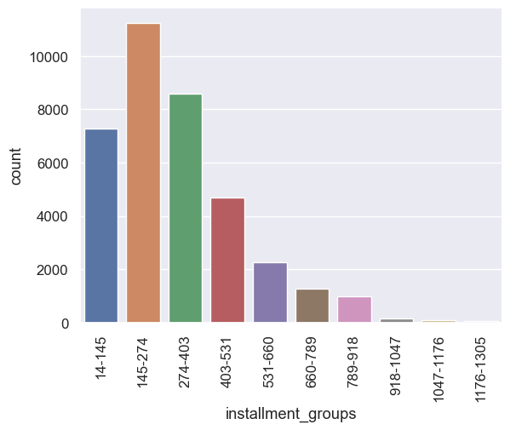
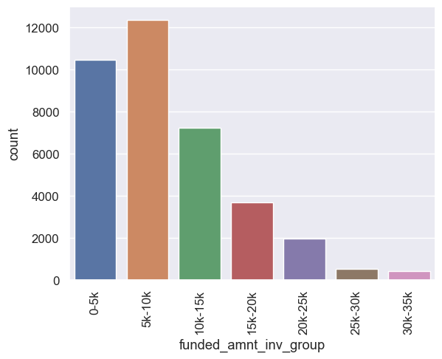
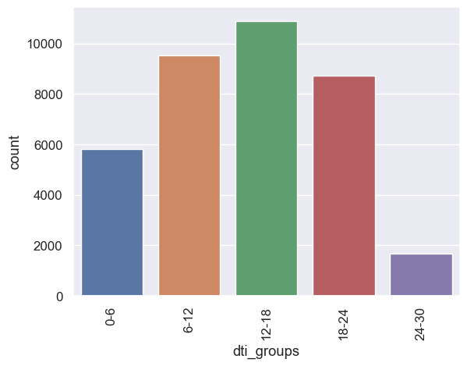
Univariate Analysis Distribution charts
Bankruptcies
Emp length
Delinq_2 years
Inquiry in last 6 months
Installment groups
Funded amt _invgroups
Dti groups

Slide 13
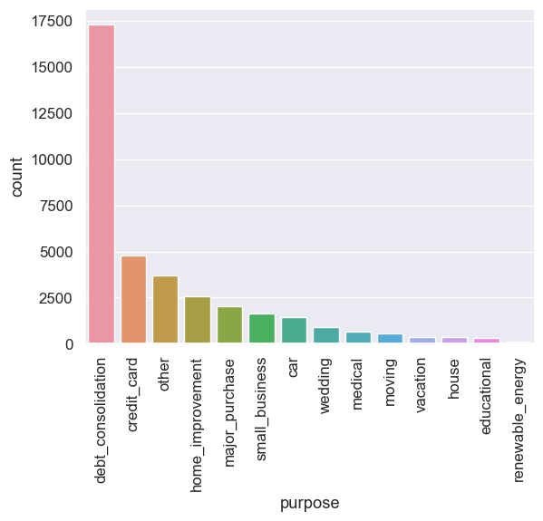
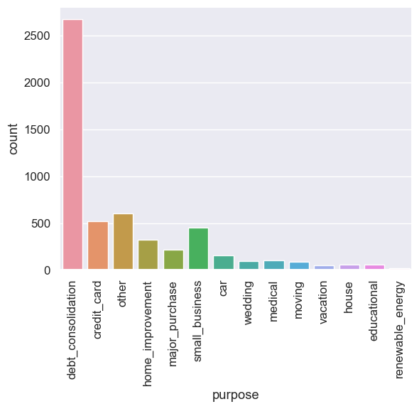
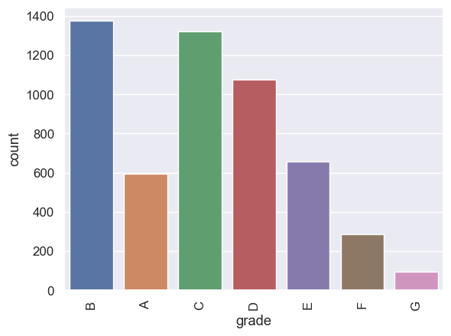
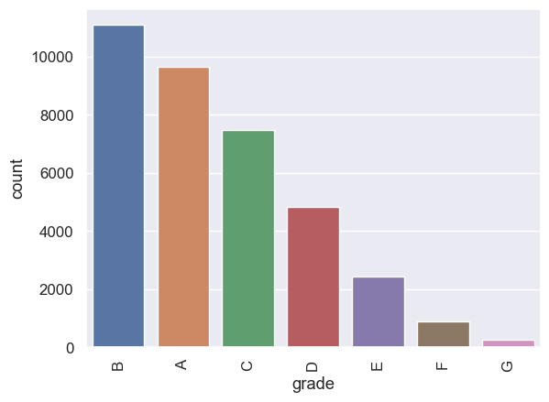
Univariate Analysis Distribution charts –Compared to charged off
Purpose – Small business charge off is much higher
Rest of the other metrics follow a similar trend from univariate analysis
All
Charged off
Grade – C, D E and F has much higher charged off then distribution of counts
All
Charged off

Slide 14
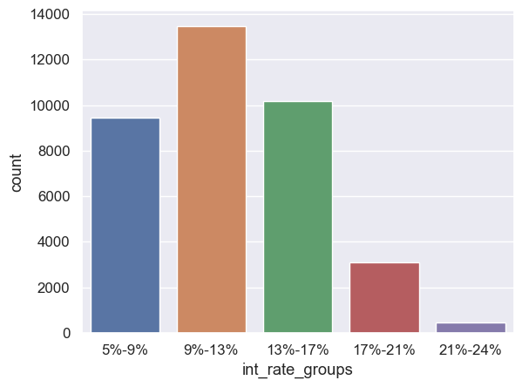
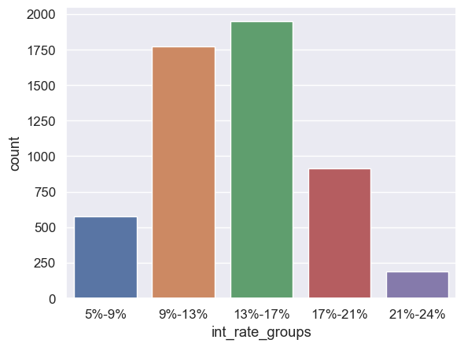
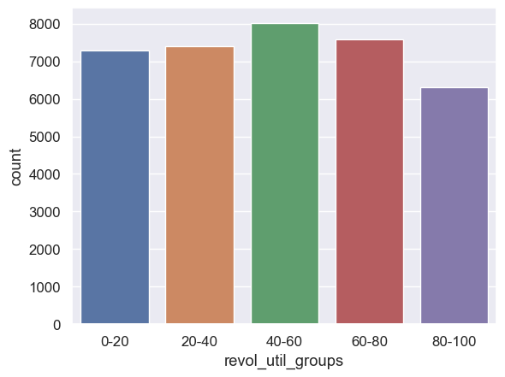
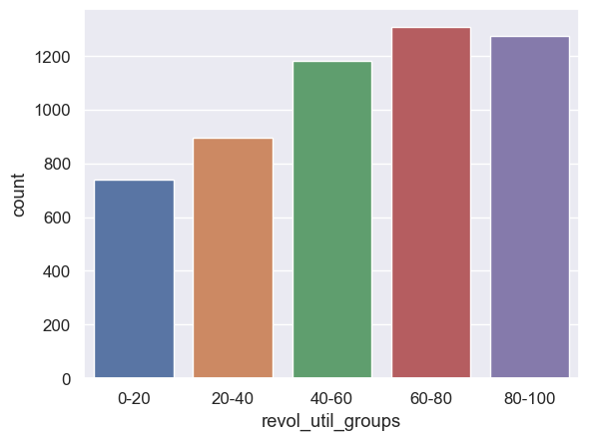
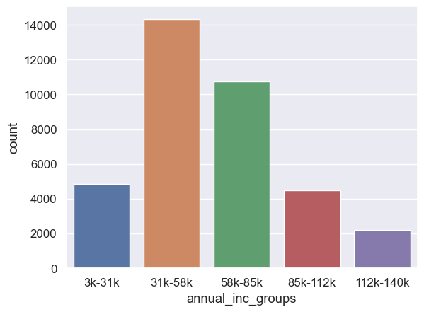
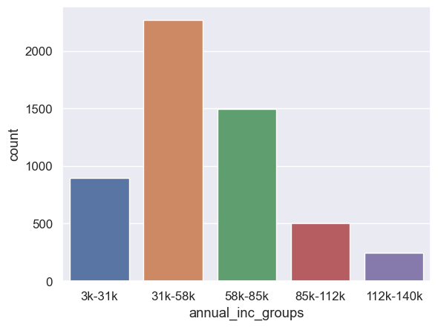
SEGMENTED Univariate Analysis Distribution charts
Interest rate – Most have 9% - 13% but most charged off is 13% - 17%
Revol_utilised – higher the utilization higher the charge off
All
Charged off
All
Charged off
Annual Income– Annual income doesn’t affect much in the distribution curve for charged off as it follows same pattern
All
Charged off

Slide 15
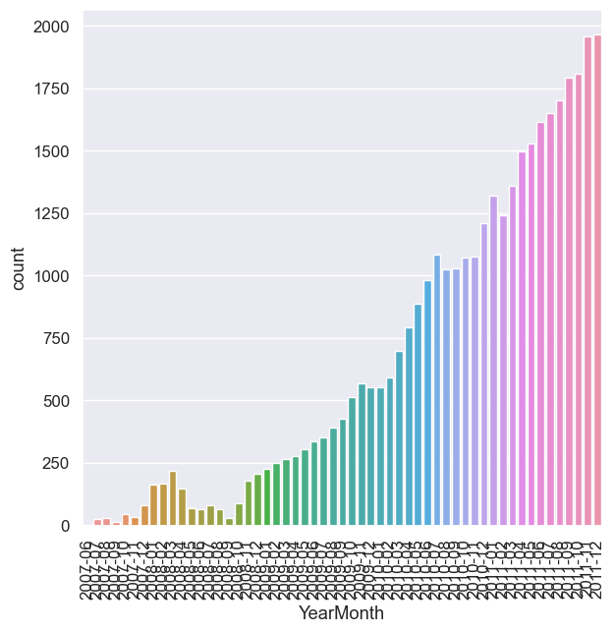
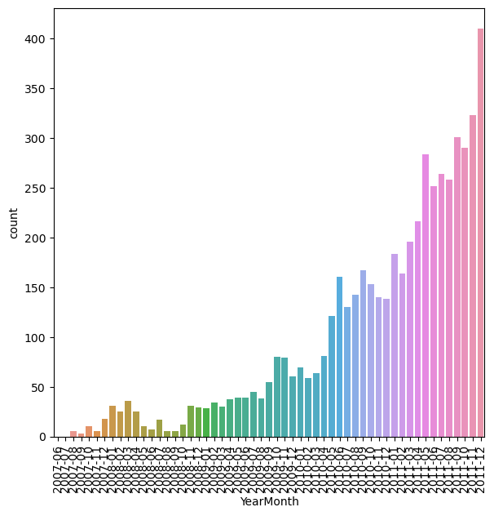
Univariate Analysis Across time
Overtime, the number of loans has increased exponentially
Charged off
All

Slide 16
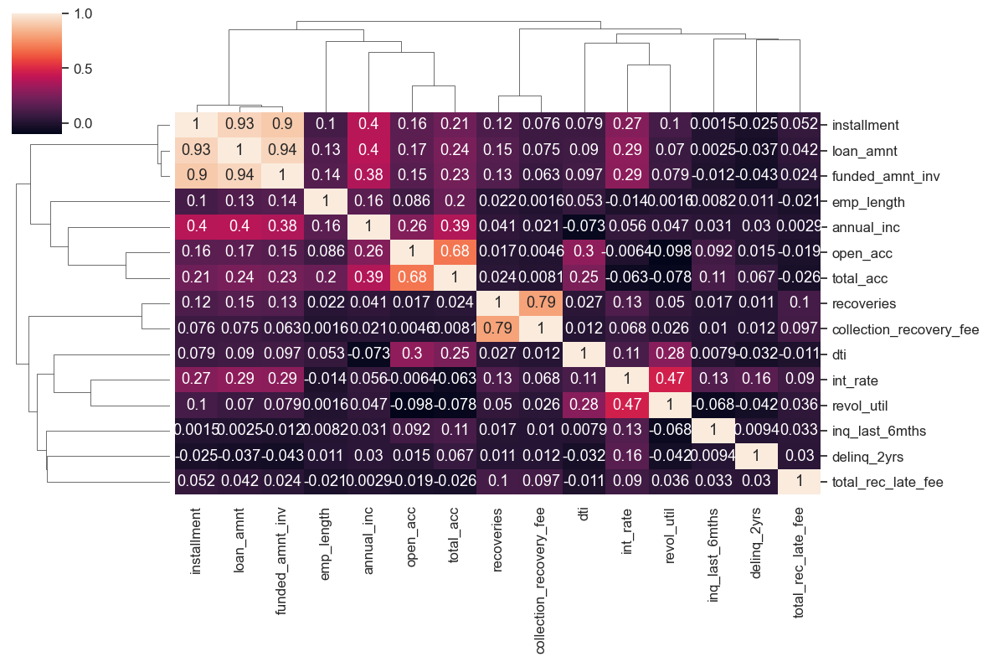
Correlation Matrix
Not many variables with a very high positive or negative correlation other than loan amount, Installment and funded amount

Slide 17
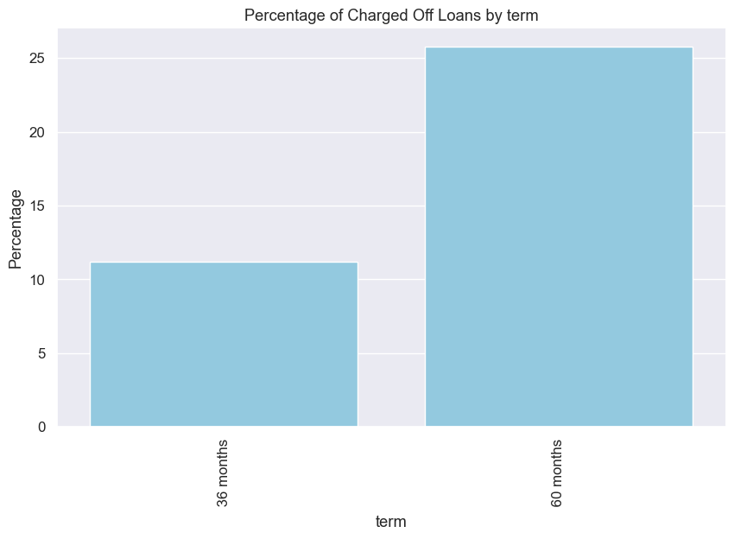
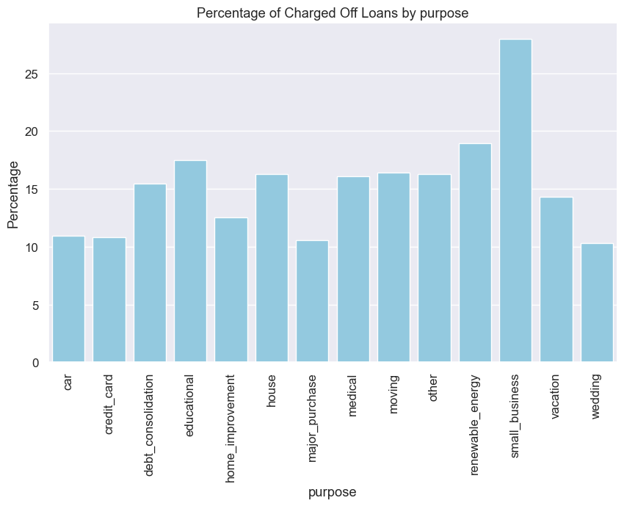
Bivariate Analysis Across % Charged OFF vs Overall
Major Observations -
60 months term has 25% chances of being charged off whereas 36 months has only 11%, this is more than double the chances of being charged off
Small businesses has a chance of more than 28% of being charged off, while second highest purpose is renewable energy at 18% of charged off

Slide 18
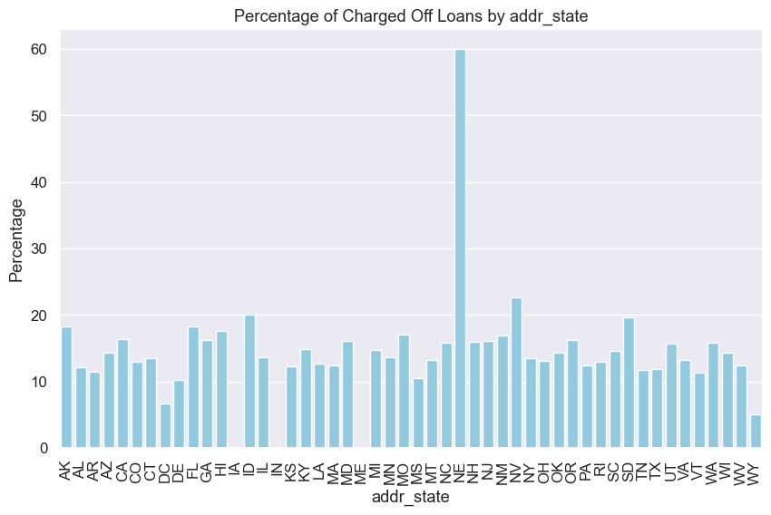
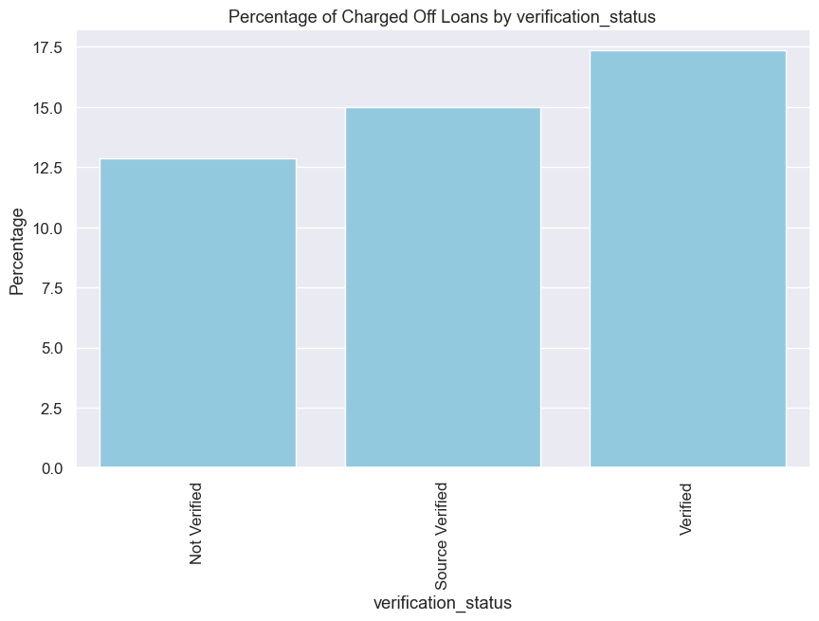
Bivariate Analysis Across % Charged OFF vs Overall
State of Nebraska has a charged off percentage of 60% which is more than 5 times the chances in any other state, but this is for a very small number of loans of 5 loans and 3 out of which is charged off
Verification is not helping as verified people have more chances of being charged off

Slide 19
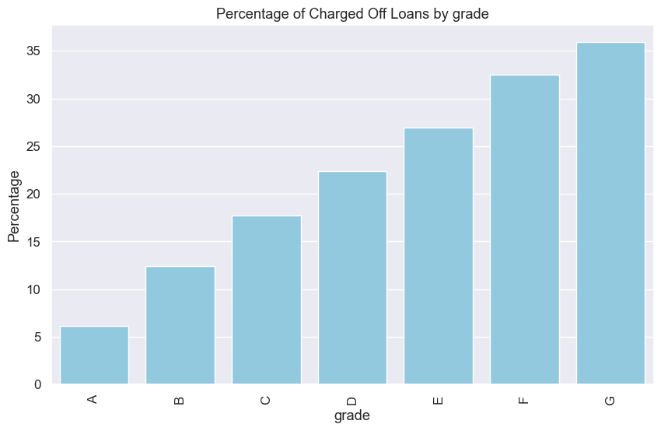
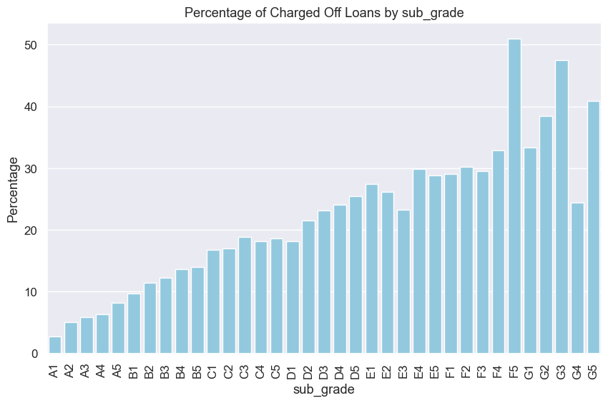
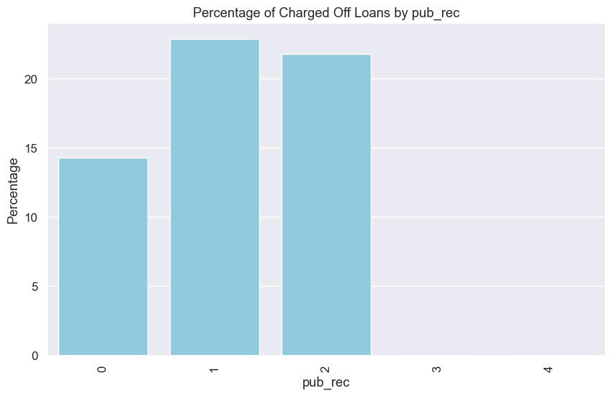
Bivariate Analysis Across % Charged OFF vs Overall
Higher the grade of the employee, higher the chances of getting charged off. G is 7 times more probable to be charged off than an A grade
Having pub records doesn't have a huge implication on the charge off status
Although we expect charged off to be high in the higher subgrades and grades, we see an anomaly for sub grade F5 where the charge off is higher than even G grade employees

Slide 20
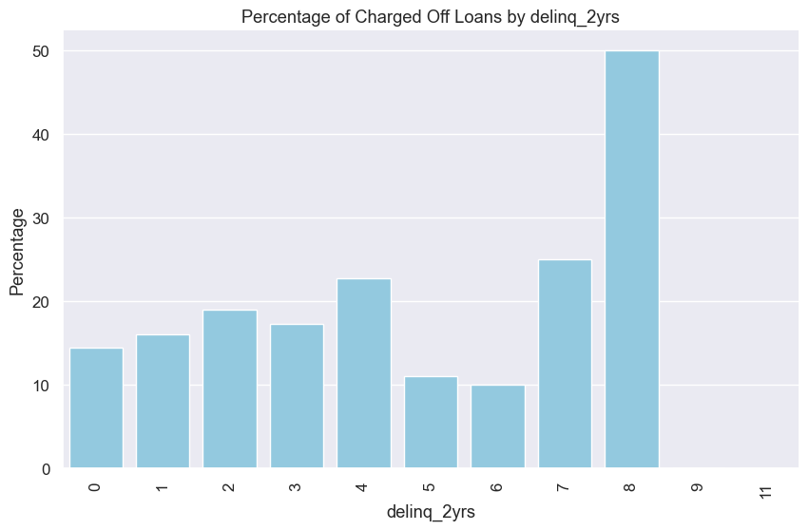
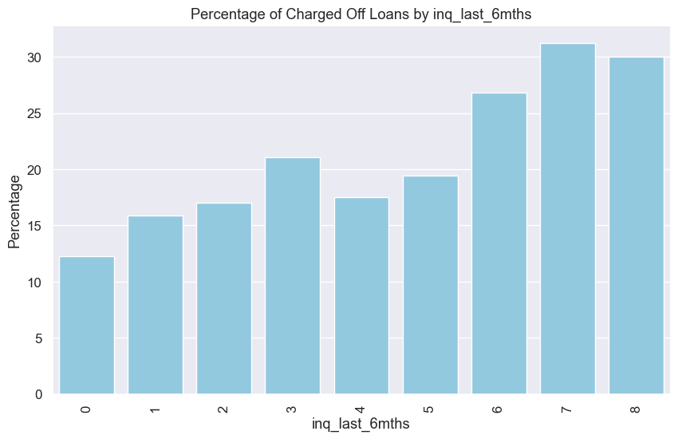
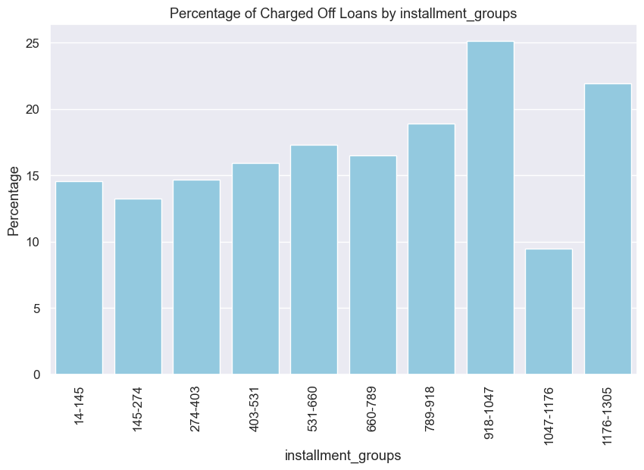
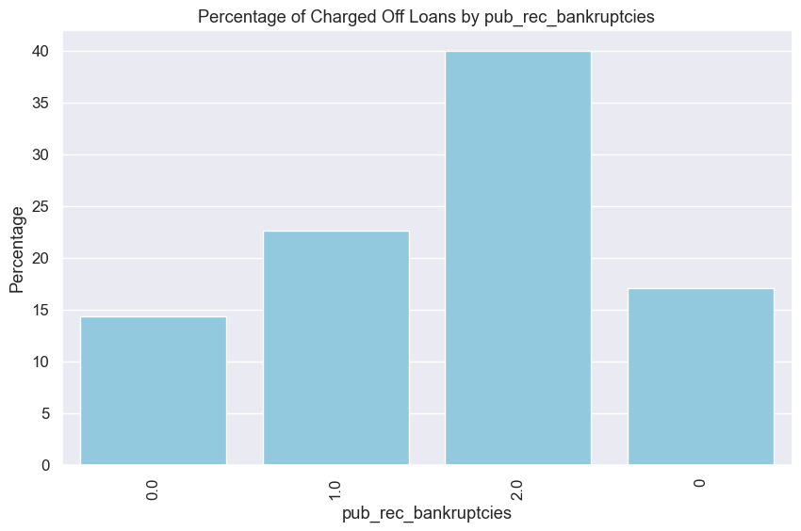
Bivariate Analysis Across % Charged OFF vs Overall
Delinq 2 years, if it touches 8 then the charged off rate goes as high as 50%
As % inquiries increases, the charge off chances also increases
As number of bankruptcies increase, the chances of charge off increases and more than doubles when you the person is 2 times bankrupt
Installment of 900-1050, has the highest chances of charge off

Slide 21
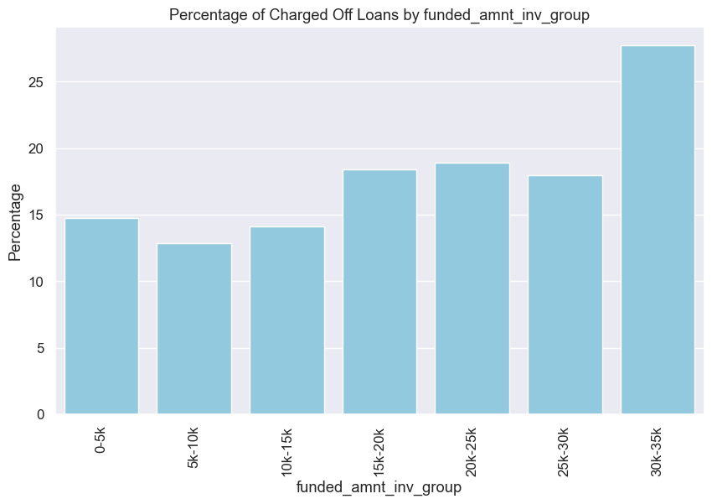
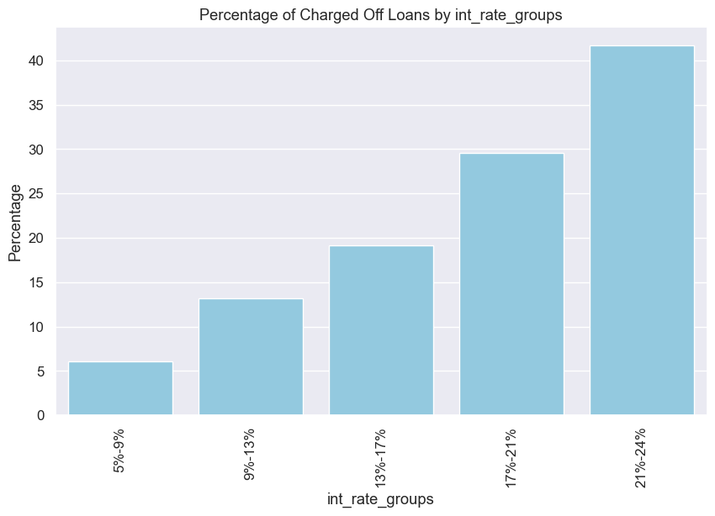
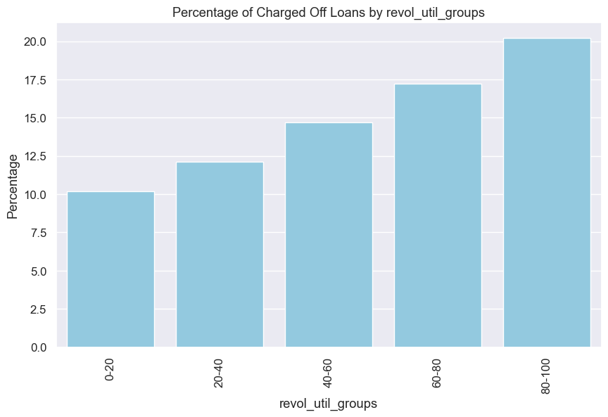
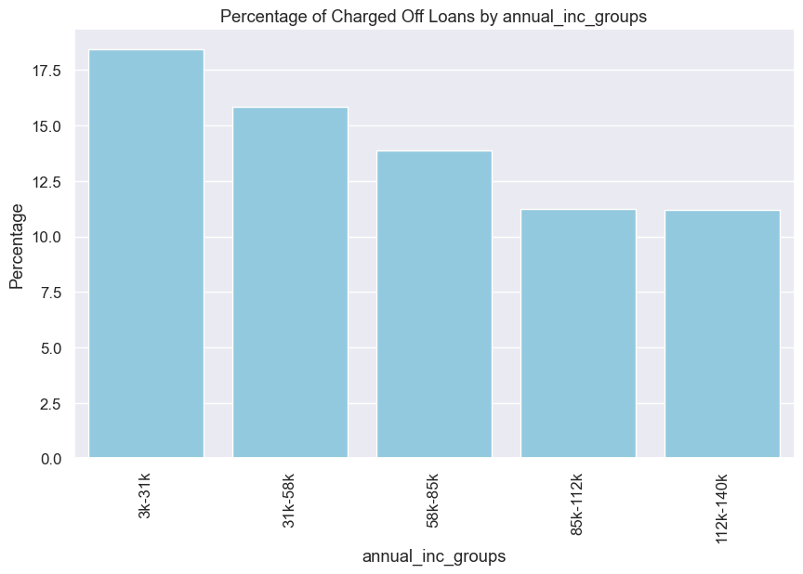
Bivariate Analysis Across % Charged OFF vs Overall
More than 30K loan amounts have a very high charge off hence we should reduce approving high loan amounts
Higher the interest rates, the charge of is much higher more than 40% compared to 5% in low int rate groups
higher the revolving credit utilized, higher is the charge of chances
Lower the annual income, higher is the charge off chance

Slide 22
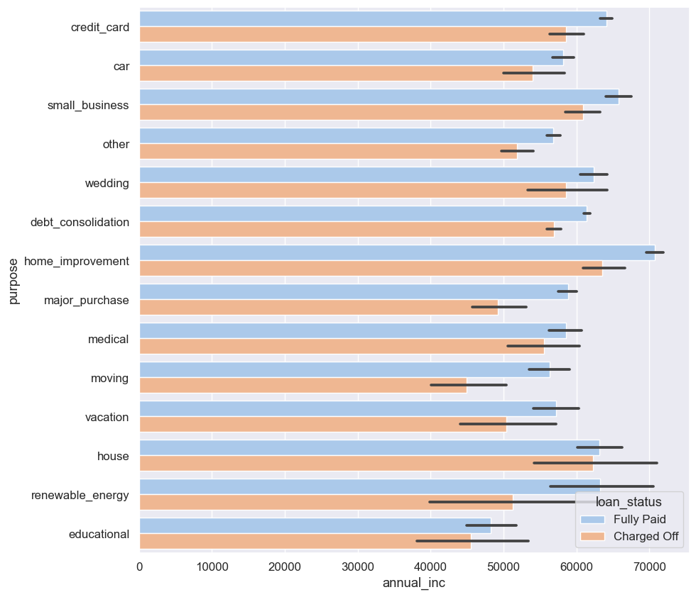
Multivariate Analysis
Renewable energy has the highest variation in salary and in charged off category
Applicants with higher salary mostly applied loans for "home_improvment", "house", "renewable_energy" and "small_businesses"

Slide 23
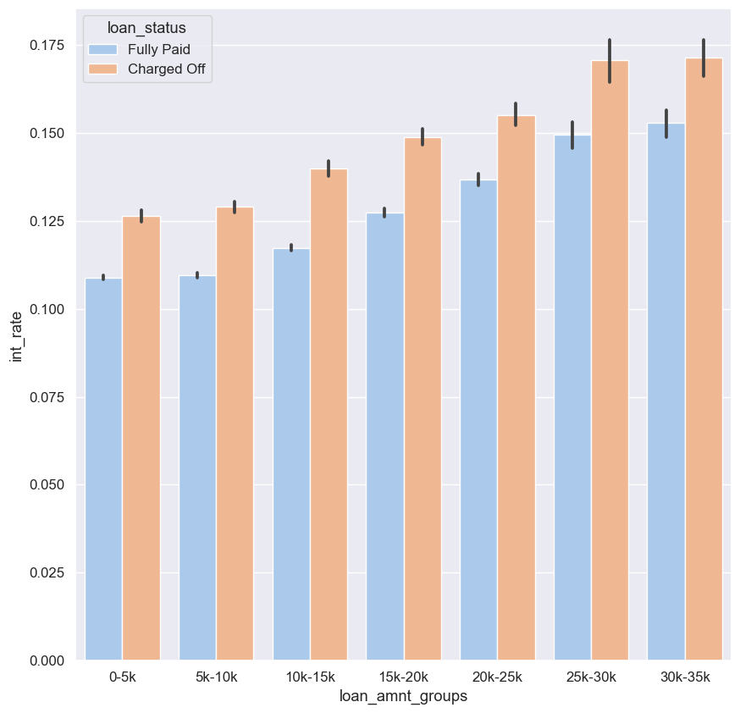
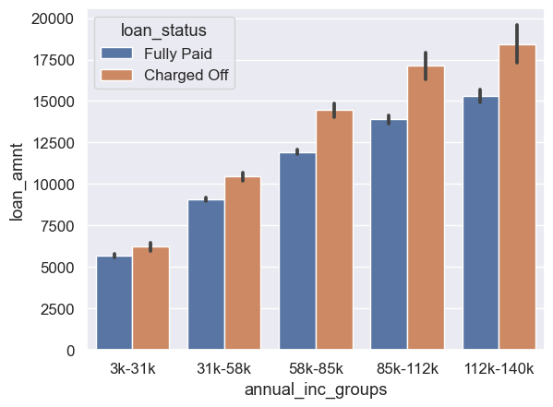
Multivariate Analysis
Across all the income groups, the loan_amount is higher for people who defaulted.
Interest rate has a bigger impact on where a loan is getting charged off than does the loan amount

Slide 24
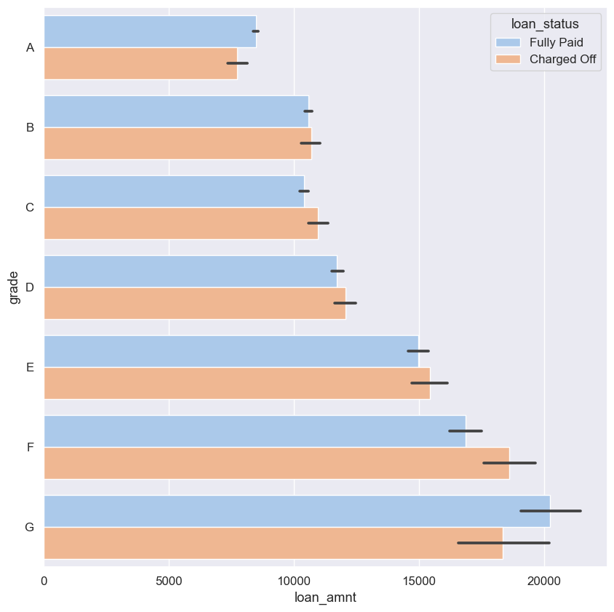
Multivariate Analysis
Higher the grade, higher is the charge off and loan amount

Slide 25
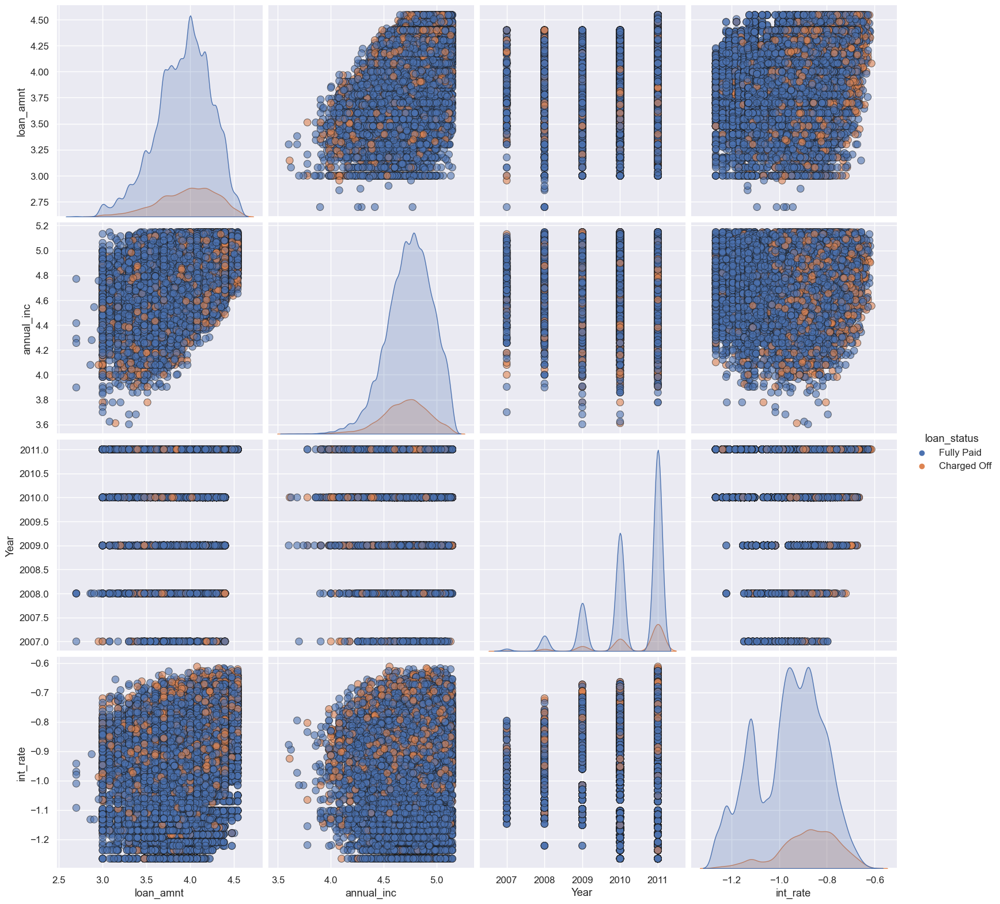
Multivariate Analysis
Higher the interest rate higher charged off ratio
Higher the annual income higher the loan amount slightly.
increase in number of charged off with increase in year.
Interest rate is increasing with loan amount increase

Slide 26

SuMMARY

Slide 27
SUMMARY
60 months term has 25% chances of being charged off whereas 36 months has only 11%, this is more than double the chances of being charged off
Small businesses has a chance of more than 28% of being charged off, while second highest purpose is renewable energy at 18% of charged off
State of Nebraska has a charged off percentage of 60% which is more than 5 times the chances in any other state, but this is for a very small number of loans of 5 loans and 3 out of which is charged off
Verification is not helping as verified people have more chances of being charged off
Higher the grade of the employee, higher the chances of getting charged off. G is 7 times more probable to be charged off than an A grade
Having pub records doesn't have a huge implication on the charge off status
Although we expect charged off to be high in the higher subgrades and grades, we see an anomaly for sub grade F5 where the charge off is higher than even G grade employees
Delinq 2 years, if it touches 8 then the charged off rate goes as high as 50%
As % inquiries increases, the charge off chances also increases
As number of bankruptcies increase, the chances of charge off increases and more than doubles when you the person is 2 times bankrupt
Installment of 900-1050, has the highest chances of charge off
More than 30K loan amounts have a very high charge off hence we should reduce approving high loan amounts
Higher the interest rates, the charge of is much higher more than 40% compared to 5% in low int rate groups
higher the revolving credit utilized, higher is the charge of chances
Lower the annual income, higher is the charge off chance

Slide 28
THANK YOU
Keval R Menon
kevalrmenon@gmail.com

